Slide 1
CO1107 Data Structure and Advance Programming: Recursion

Slide 2

Class Activity

Slide 3
What would be the output of the following code:
def func1():
print(1)
func2()
print(4)
def func2():
func3()
print(2)
def func3():
print(3)
func1()
1, 4, 2, 3
1, 2, 3, 4
1, 3, 2, 4
None of the above
C

Slide 4
What would be the output of the following code:
def goSleep(level):
print("In dream at level",level)
goSleep(level+1)
goSleep(1)
The function never exits (until crashed)
Prints “In dream at level 1”
Continues printing “In dream at level …” forever (or until the program crashes)
Invalid code. A function cannot call itself

Slide 5
What would be the output of the following code:
def goSleep(level):
print("In dream at level",level)
# wake up if at level 3 (Called base case in recursion)
if level == 3:
print("This is the deepest I can go")
print("Waking up from level",level)
else:
print("I am going deeper to level",level+1)
goSleep(level+1)
print("Waking up from level",level)
goSleep(1)
In dream at level 1
I am going deeper to level 2
In dream at level 2
I am going deeper to level 3
In dream at level 3
This is the deepest I can go
Waking up from level 3
Waking up from level 2
Waking up from level 1

Slide 6
What a function to print all the number from N to 1:
def printNumbers(N):
for i in range(N,0,-1):
print(i)
printNumbers(5)
5
4
3
2
1

Slide 7
What is Recursion Algorithm
Recursion is a function which it call itself
Solve a large problem by solving a sub-problems
Sub-problems are the same kind as the original problem and they can be solved with the same algorithm
Simpler to solve: sub-problems are so simple that they can be solved without further reductions (base case)
It needs at least one base case to stop recursive calls otherwise the program will crash.

Slide 8
Candidate problems for recursion
Must be possible to decompose them into simpler similar problems
At some point, the problems must become so simple that can be solved with no further decomposition
Once all sub-problems are solved, the solution to the original problem can be computed by combining these solutions

Slide 9
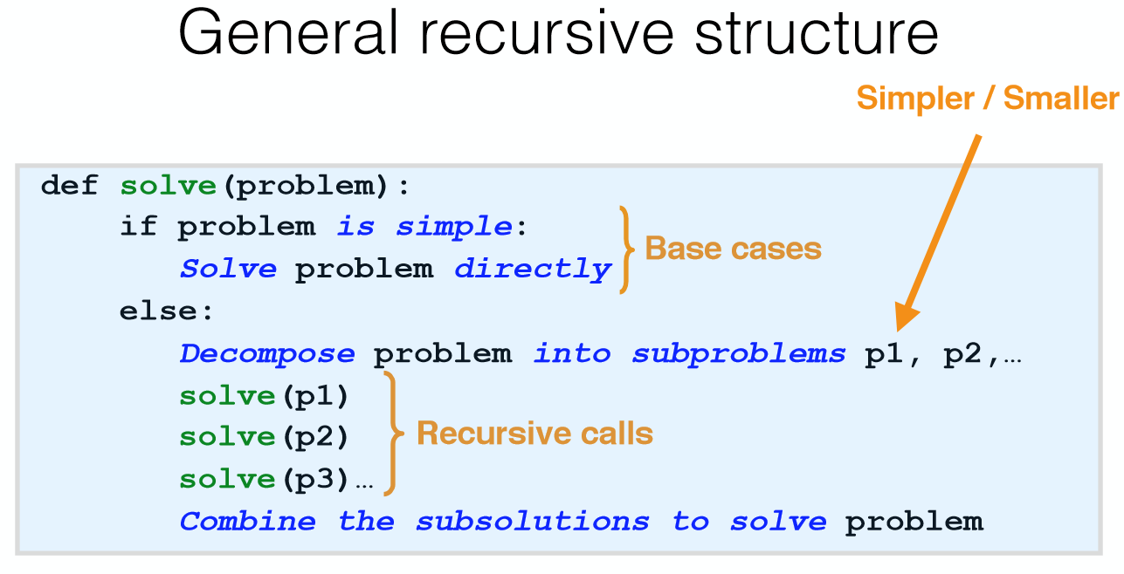
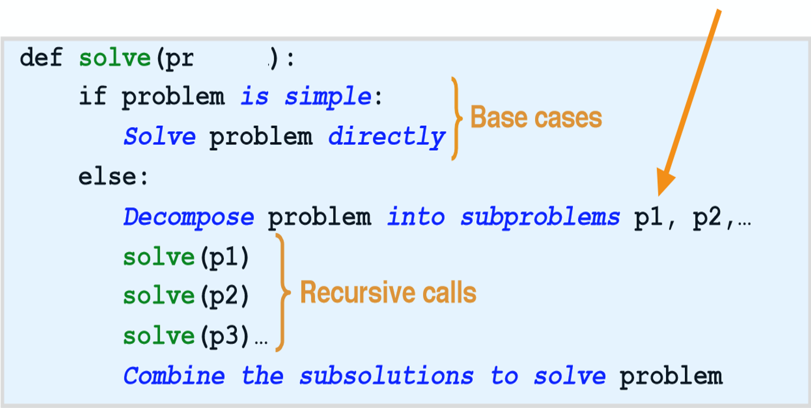

Slide 10
Add numbers from 1 to N
def addNumbers(N):
if N == 0:
return 0
else:
subtotal = addNumbers(N-1)
return subtotal + N
total = addNumbers(5)
print(total)
Can be done in one statement as
return addNumbers(N-1) + N
def addNumbers(N):
while N > 0:
subtotal = N + subtotal
N -= 1
return subtotal
total = addNumbers(5)
print(total)

Slide 11
Printing numbers from N to 1 without a loop
def printNumbers(N):
print(N)
if N == 1:
pass # do nothing
else:
printNumbers(N-1)
printNumbers(5)
Base case

Slide 12
Which values are printed by the code and in which order?
def printNumbers(N):
if N > 1:
printNumbers(N-1)
print(N)
printNumbers(3)
1,2,3
3,2,1
3
None of the above
A

Slide 13
What will be printed by the print(code) at last line?
def goSleep(level):
print("In dream at level",level)
if level == 3:
print("Reached level 3")
code = 42
print("Got the code, returning it")
return code
else:
print("I am going deeper to level",level+1)
code = goSleep(level+1)
print("Got the code, code is",code)
code = goSleep(1)
print(code)
42
None
Error message
This option because I have not chosen D in a while
B

Slide 14
Write a recursive function to compute the factorial
def getFactorial(N):
if N==0:
return 1
else:
return N*getFactorial(N-1)
print(getFactorial(5))
Solution for base case (e.g., N = 0)?
1
Assume you know the solution for smaller problem (i.e., (N-1)!), what will be the solution for N.
N! = N * (N-1)!

Slide 15
Class Activity
Write a recursive function that takes as input a positive integer n and returns a list L that contains the factorial values, 1!, 2!, ..., n!.
For example: If the input is n=5, then the output should be:
[1, 2, 6, 24, 120].

Slide 16
Solution
def factorialList (n):
if n == 1:
ansList = [0] * n
ansList [0] = 1
else :
ansList = factorialList(n-1)
ansList.append(n*ansList[n-2])
return ansList
value=int (input("Enter the range : "))
print( factorialList ( value ))

Slide 17
Write a program to compute power using recursion : Power ( 2,3 ) = 2 ** 3 = 8
#computes x**N
def Power(x,N):
if N==0:
return 1
else:
return x*Power(x,N-1)
print(Power(3,4))
Solution for base case (x**0 = 1)
Assume you know solution for x**(N-1)
x**N = x*x**(N-1)

Slide 18
What will be printed by the following code?
def doSomething(aList):
n = len(aList)
if n == 0:
return 0
else:
return aList[0] + doSomething(aList[1:])
L = [10,30,20]
value = doSomething(L)
print(value)
Solution for base case (sum is zero if list is empty)
Sum of all elements = first element + sum of remaining elements in the list
30
10
40
60
None of the above

Slide 19
What is the next number in the following sequence? 0, 1, 1, 2, 3, 5, 8, 13, 21
29
34
26
None of the above

Slide 20
Algorithm Fib(N)
// Compute the Nth Fibonacci Number
// Input: A non negative integer N.
// Output: The Nth Fibonacci number
if (N = 0 or N = 1)
return N
else
return Fib(N-2) + Fib(N-1)

Slide 21
Computing n-th Fibonacci number
def fib(n):
if n == 0 or n == 1:
return n
else:
return fib(n-2)+fib(n-1)
print(fib(6))
Solution for base case. 0-th number is 0 and 1st number is 1.
n-th number is the sum of (n-2)-th number and (n-1)-th number

